Slide 1
Analytic Approach Of Employee Satisfaction Index Using Naive Bayes Algorithm
Presented By
Bhimireddy Cotton
Guided By
Dr.Sankari M

Slide 2
Abstract
In IT companies, the human resource is the driving factor of the company's growth which depends on employees' motivation, skills and quality of work. Now a days the competitive advantage of most companies on global market lies in the ability to create a profit driven not only by cost efficiency, but by the ideas and intellectual know-how. So most organizations and companies are seeking talented, knowledgeable and experienced candidates for their job openings. Employee Satisfaction is a measure of workers contentedness with their job. Different factors may cause a change in the level of employee satisfaction. Every industry has different business environment, different policies for employment and different compensation measures. The goal of this project is to propose a employee satisfaction model to predict the measure of whether employees are satisfied or not. Naive bayes algorithm will be used for predictive model generation. Using this model, the factors affecting the employee satisfaction index will be identified and the company will provide handholding, care and support to the employees.

Slide 3
Hardware Requirements
Processor : Processor Intel CORE i3 and above
Internet Connection : Existing telephone lines, Data card, Fiber net
RAM : 4 GB
Software Requirements
Operating System : Windows, Mac, Linux
Language : R Programming – R-4.1.3
GUI : RStudio

Slide 4
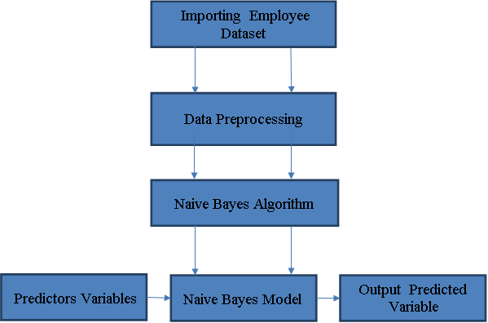
Architectural Diagram

Slide 5
Project Modules
There are four Modules
Importing Employee dataset
Data Preprocessing
Model Generation Using Naive Bayes Algorithm
Prediction using Naive Bayes Model

Slide 6
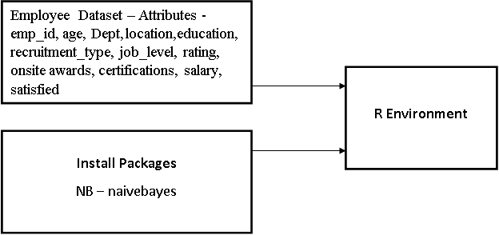
Importing Employee Dataset
Data have to be imported in to R environment for analysis.
Data can be any format like txt, .csv, .xlsx, .SPSS etc.
Package necessary for Naive Bayes algorithm have to be installed and loaded in to the program. NB – naivebayes

Slide 7
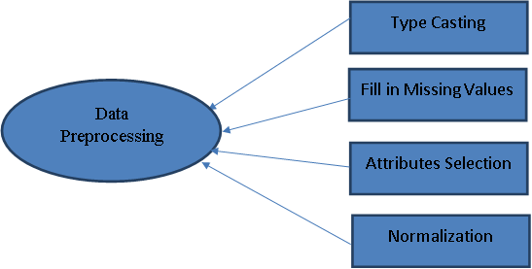
Data Preprocessing
In Data Preprocessing, it is not necessary to hold all the attributes for doing the analysis, we can hold only the attributes which is affecting the analysis.
.

Slide 8
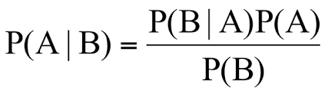
Model Generation Using Naive Bayes Algorithm
Naive Bayes is a classification and prediction algorithm based on Bayes Theorem.
Bayes Theorem
P(A|B) - Probability of occurrence of event A given the event B is true - Posterior Probability
P(A) - Probabilities of the occurrence of event A - Class prior Probability
P(B) - Probabilities of the occurrence of event B – Predictor Prior Probability
P(B|A) - Probability of the occurrence of event B given the event A is true - Likelihood

Slide 9
Model Generation Using Naive Bayes Algorithm
Steps in Naive Bayes algorithm
Step 1: Convert the data set into a frequency table
Step 2: Create Likelihood table by finding the probabilities values of each attributes
Step 3: Now, use Naive Bayesian equation to calculate the posterior probability for each class. The class with the highest posterior probability is the outcome of prediction.

Slide 10
Model Generation Using Naive Bayes Algorithm
Day | Outlook | Temp | Humidity | Windy | Play Ball
1 | Sunny | Hot | High | Weak | No
2 | Sunny | Hot | High | Strong | No
3 | Overcast | Hot | High | Weak | Yes
4 | Rain | Mild | High | Weak | Yes
5 | Rain | Cool | Normal | Weak | Yes
6 | Rain | Cool | Normal | Strong | No
7 | Overcast | Cool | Normal | Strong | Yes
8 | Sunny | Mild | High | Weak | No
9 | Sunny | Cool | Normal | Weak | Yes
10 | Rain | Mild | Normal | Weak | Yes
11 | Sunny | Mild | Normal | Strong | Yes
12 | Overcast | Mild | High | Strong | Yes
13 | Overcast | Hot | Normal | Weak | Yes
14 | Rain | Mild | High | Strong | No
Outlook |  |  | Temp |  |  | Humidity |  |  | Windy |  |  | Play Ball
 | Y | N |  | Y | N |  | Y | N |  | Y | N | Y | N
Sunny | 2 | 3 | Hot | 2 | 2 | High | 3 | 4 | Weak | 6 | 2 | 9 | 5
Overcast | 4 | 0 | Mild | 4 | 2 | Normal | 6 | 1 | Strong | 3 | 3
Rainy | 3 | 2 | Cool | 3 | 1
Sunny | 2/9 | 3/5 | Hot | 2/9 | 2/5 | High | 3/9 | 4/5 | Weak | 6/9 | 2/5 | 9/14 | 5/14
Overcast | 4/9 | 0/5 | Mild | 4/9 | 2/5 | Normal | 6/9 | 1/5 | Stg | 3/9 | 3/5
Rainy | 3/9 | 2/5 | Cool | 3/9 | 1/5
P(S,C,H,S) = P(S)*P(C)*P(H)*P(S)
= 5/14 * 4/14 *7/14*6/14 = 0.0216
Likelihood for Yes = 2/9 * 3/9 * 3/9* 3/9 = 0.0082
Likelihood for No = 3/5 * 1/5 * 4/5* 3/5 = 0.0576
Posterior Probability of Yes = (0.0082* 9/14) / 0.0216 =0.245
Posterior Probability of No = (0.0576 * 5/14) / 0.0216 =0.952
The posterior probability for the No is higher, so the probability of no is higher.
Bayes Theorem
Sunny, Cool, High, Strong
P(Yes |S,C,H,S) = P(S,C,H,S | Yes) *P(Yes) / P(S,C,H,S)
P(No | S,C,H,S) = P(S,C,H,S | No) *P(No) / P(S,C,H,S)

Slide 11

Prediction using Naive Bayes Model
Once Naive Bayes model have been created,
By using testing data, model can be evaluated
By giving only predictor variables, target variable can be predicted.

Slide 12
Naive Bayes Model
Sample Data Sets
emp_id | age | Dept | location | education | recruitment_type | job_level | rating
HR8270 | 28 | HR | Suburb | PG | Referral | 5 | 2
TECH1860 | 50 | Technology | Suburb | PG | Walk-in | 3 | 5
TECH6390 | 43 | Technology | Suburb | UG | Referral | 4 | 1
SAL6191 | 44 | Sales | City | PG | On-Campus | 2 | 3
HR6734 | 33 | HR | City | UG | Recruitment Agency | 2 | 1
PUR7265 | 40 | Purchasing | Suburb | UG | Referral | 3 | 3
PUR1466 | 26 | Purchasing | Suburb | UG | Referral | 5 | 5
TECH5426 | 25 | Technology | City | UG | Recruitment Agency | 1 | 1
HR6578 | 35 | HR | City | PG | Referral | 3 | 4
TECH9322 | 45 | Technology | City | PG | Referral | 3 | 3
MKT2685 | 31 | Marketing | City | UG | Walk-in | 4 | 4
TECH1769 | 43 | Technology | Suburb | PG | Recruitment Agency | 2 | 1
TECH7949 | 28 | Technology | City | UG | On-Campus | 3 | 4
PUR3433 | 48 | Purchasing | Suburb | PG | Referral | 3 | 4
PUR6311 | 52 | Purchasing | City | PG | Recruitment Agency | 5 | 1
PUR6051 | 50 | Purchasing | City | UG | Walk-in | 5 | 5
MKT7420 | 34 | Marketing | City | PG | On-Campus | 1 | 4
PUR2184 | 24 | Purchasing | Suburb | UG | Recruitment Agency | 4 | 4
HR5555 | 54 | HR | Suburb | PG | On-Campus | 1 | 5
SAL4385 | 25 | Sales | City | UG | On-Campus | 5 | 4
HR7396 | 25 | HR | Suburb | UG | On-Campus | 2 | 4
HR9666 | 50 | HR | Suburb | PG | Referral | 5 | 4
PUR3558 | 34 | Purchasing | City | PG | Referral | 4 | 2
SAL8849 | 37 | Sales | City | UG | Walk-in | 5 | 5
SAL3047 | 31 | Sales | Suburb | PG | Walk-in | 4 | 4

Slide 13
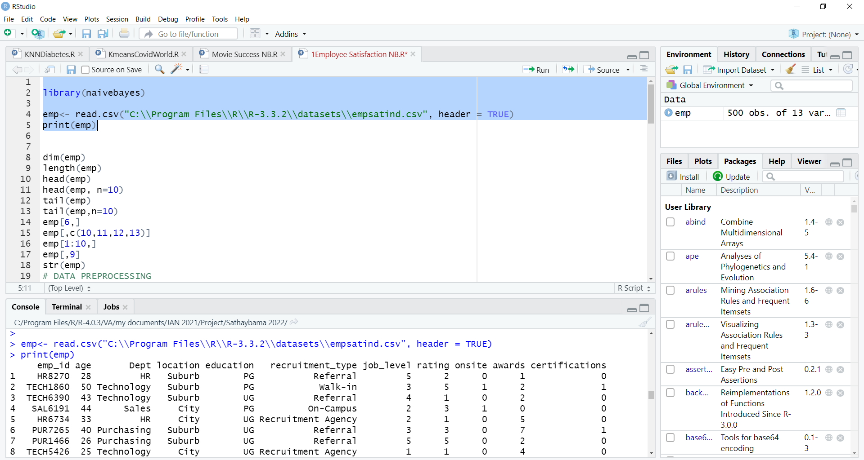
Naive Bayes Model
Data Importing

Slide 14
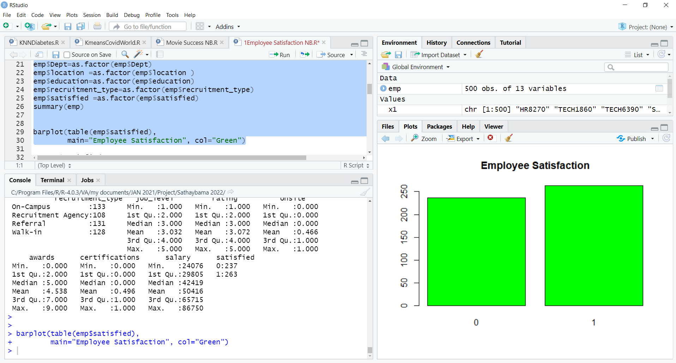
Naive Bayes Model
Data Preprocessing

Slide 15
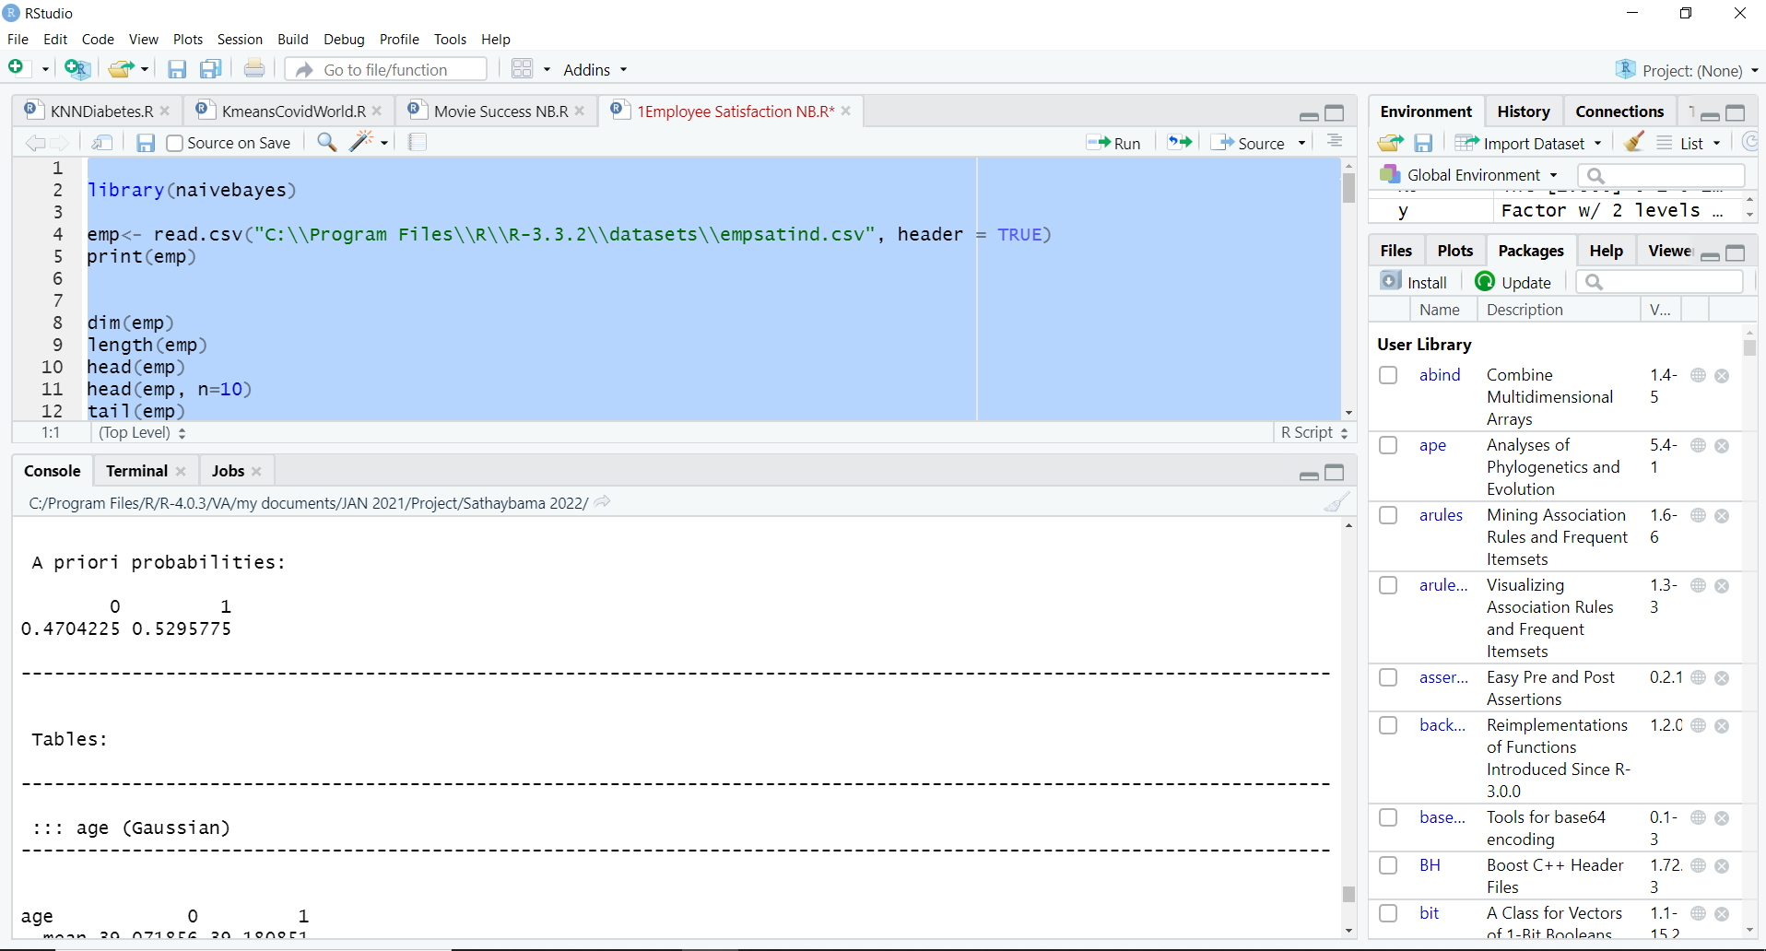
Naive Bayes Model
Naive Bayes Classification Model

Slide 16
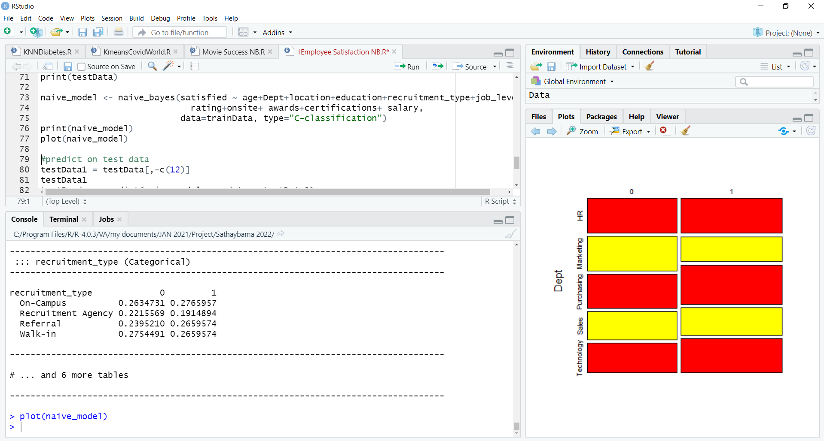
Naive Bayes Model
Naive Bayes Classification Model

Slide 17
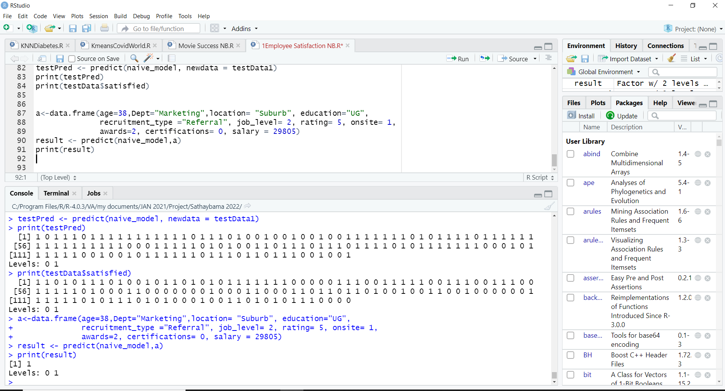
Naive Bayes Predictive Model

Slide 18
Job satisfaction is defined as a pleasurable or positive emotional state from the appraisal of one's job or experiences. This project presents a recommendation system that uses Data Science algorithm for predicting, the job satisfaction of employees in the company. The Naive Bayes Data Science algorithm is used for predicting whether the employee is having job satisfaction or not. Thus, this project concludes, Naive Bayes Algorithm performs better and faster when compared to other statistical techniques. This project can be further extended using some more data science algorithm and deep learning algorithms to improve the performance of prediction system. Foreseeing the employees' job satisfaction makes it easy for a company to take swift actions to improve the job satisfaction of its employees.
Conclusion
Notes:
‹#›

Slide 19
1. Nimasha Arambepola; Lankeshwara Munasinghe,“ What makes job satisfaction in the information technology industry? ", International Research Conference on Smart Computing and Systems Engineering (SCSE),2021 2. Jia Yuan, “Research on Employee Turnover Prediction Based on Machine Learning Algorithms ", IEEE International Conference on Intelligent Engineering and Managemen International Conference on Artificial Intelligence and Big Data (ICAIBD), 2021 3. Jinny Rhee; Sheri Sheppard, " Impact of Lifestyle and Working Process Organization on the Job Satisfaction Level of Software Engineers", IEEE/ACM 41st International Conference on Software Engineering: Companion Proceedings (ICSE-Companion), 2019. 4. Jieshi Chen, Aldabbagh Ghadah, “Confucian values and job performance of IT employees in Guangdong-Hong Kong-Macao Greater Bay Area ", IEEE International Conference on Education, Knowledge and Information Management (ICEKIM), 2021. 5. K. Ramamurthy et al., "Identifying employees for re-skilling using an analytics-based approach", IEEE ICDM, pp. 345-354, 2015.
References
Notes:
‹#›

Slide 20
